Slide 1


PREDICTION OF ADVERTISING STRATEGY USING LINEAR REGRESSION
A Minor Project Report
in partial fulfillment of the degree
Bachelor of Technology
in
Computer Science & Artificial Intelligence
By
2003A522085 G. Sai Krishna Priya
2303A51LB6 K. Deepak Chary
Under the Guidance of
Dr. Kiran Eranki Assoc. Prof, CS&AI Department
Submitted to
SCHOOL OF COMPUTER SCIENCE & ARTIFICIAL INTELLIGENCE
SR UNIVERSITY, ANANTHASAGAR, WARANGAL
April, 2023.

Slide 2
ABSTRACT
Marketing data analysis is a technique where the business will take all the available information regarding the market and come up with a marketing plan. It is a very vital piece of activity for any sort of business. It also shows you how well you have done in the market using your current marketing techniques. Already existing solutions would be the predictive sales after marketing but in this problem statement we used various modes of marketing. The future scope for the project will be that as the main aim of this project is to know the relation among the sales ang the mode of marketing platform, the users can analyze and choose best platform so that they get maximum profits. By using this they need not invest their money in all the modes of marketing but instead choose a best one. In other mays it will also help the user to know how much average amount need to be spent for marketing.

Slide 3
PROBLEM STATEMENT
The problem statement we encountered is to find out the difference between the previous sales as well as the sales once after the product is being advertised through different platforms.

Slide 4
OBJECTIVES
Objective of this paper is to develop a system that predicts the rate of sales in specific year is increased or decreased. This is taken into consideration after observing all the amount spent on different modes of advertising like tv ads, radio ad, social media sponsoring and being advertised or suggested by any of the influencer.

Slide 5
Literature Review
Once after selecting the problem statement the first thing, we started with is the collection if the dataset. In which we took the help of bowser to know how on an average a brand or company spends for advertising their product. Later after collecting all the data in different attributes, we collected the values of their previous sales through browsing networks.

Slide 6
Proposed Methodology
The proposed methodology for advertising strategy involves conducting market research to understand the target audience, identifying key messaging and channels, creating compelling ad creatives, testing and optimizing campaigns, and measuring success using relevant metrics. This process should be iterative and informed by data-driven insights to drive effective and efficient advertising outcomes.

Slide 7
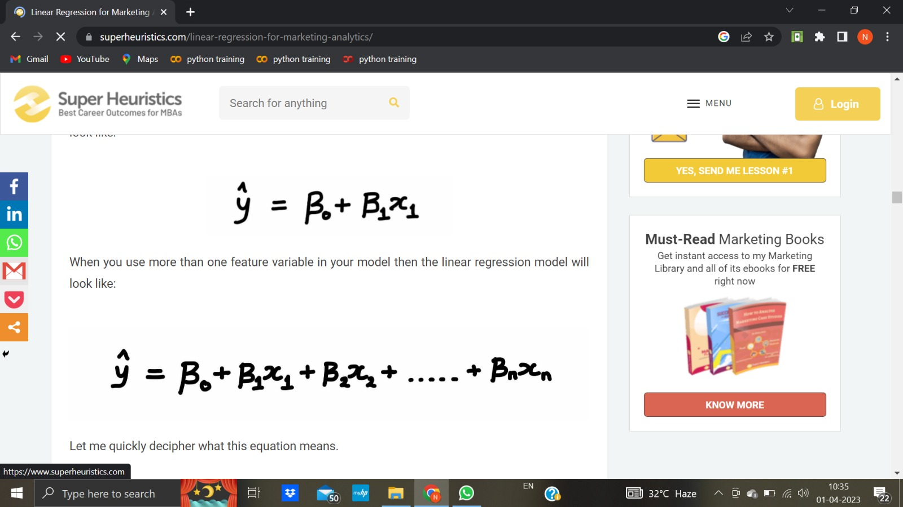
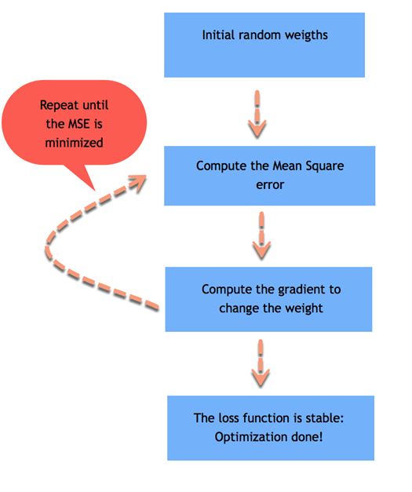
Proposed ALGORITHM
linear regression is supervised learning algorithm
111

Slide 8
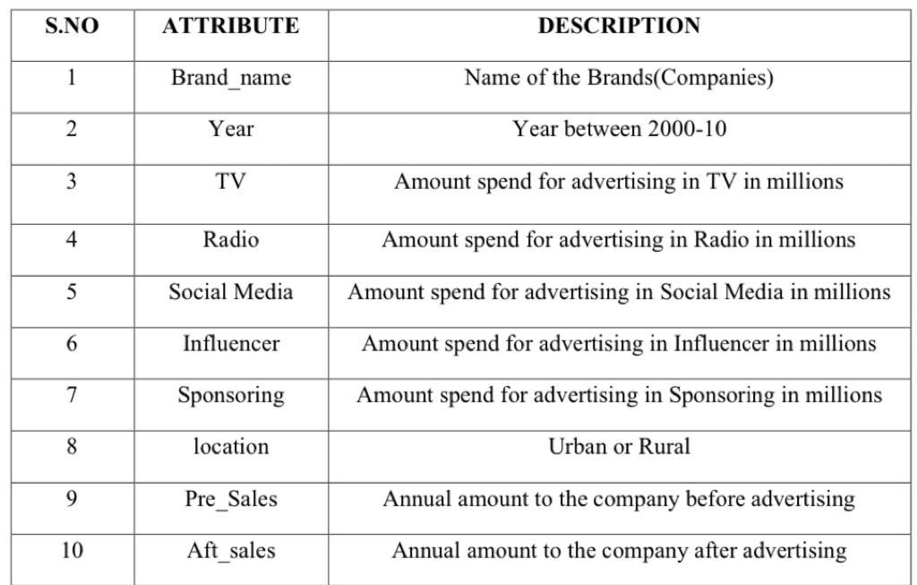
DATA SET
The dataset we created consists of 350 rows and 10 columns i.e.., 10 attributes. In detail,

Slide 9
LINEAR REGRESSION
Linear Regression is an ML algorithm used for supervised learning. Linear regression performs the task to predict a dependent variable(target) based on the given independent variable(s). So, this regression technique finds out a linear relationship between a dependent variable and the other given independent variables.

Slide 10
Prediction of Advertising strategy
Model Training: Train the linear regression model on the training data to find the coefficients that best fit the data. The model learns the relationship between the dependent variable and independent variables. The linear regression model is based on the equation of a straight line, y = mx + b, where y is the dependent variable, x is the independent variable, m is the slope of the line, and b is the y-intercept. The model finds the best values for m and b that minimize the difference between the predicted values and the actual values.Model Evaluation: Evaluate the model on the testing data to see how well it performs. This is done by calculating the error between the predicted values and the actual values. There are several metrics to evaluate a linear regression model, such as mean squared error (MSE), root mean squared error (RMSE), and coefficient of determination (R-squared).

Slide 11
Result:
we have trained our model with different independent variables such Aft_sales , TV , Pre_salesAft_sales:
training accuracy : 92.64 %
testing accuracy : 95.74 %
total accuracy : 92.86%
MSE : 2.84
Tv :
training accuracy : 99.9 %
testing accuracy : 99.7 %
total accuracy : 99.8%
MSE : 0.80
pre_sales:
training accuracy : 99.9 %
testing accuracy : 99.7 %
total accuracy : 99.8%
MSE : 2.81
we got accuracy for tv , aft_sales ,pre_sales attributes

Slide 12
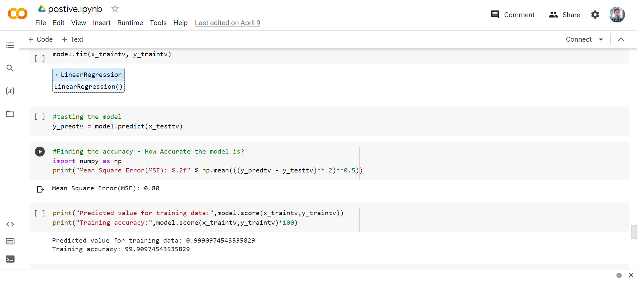
Results

Slide 13
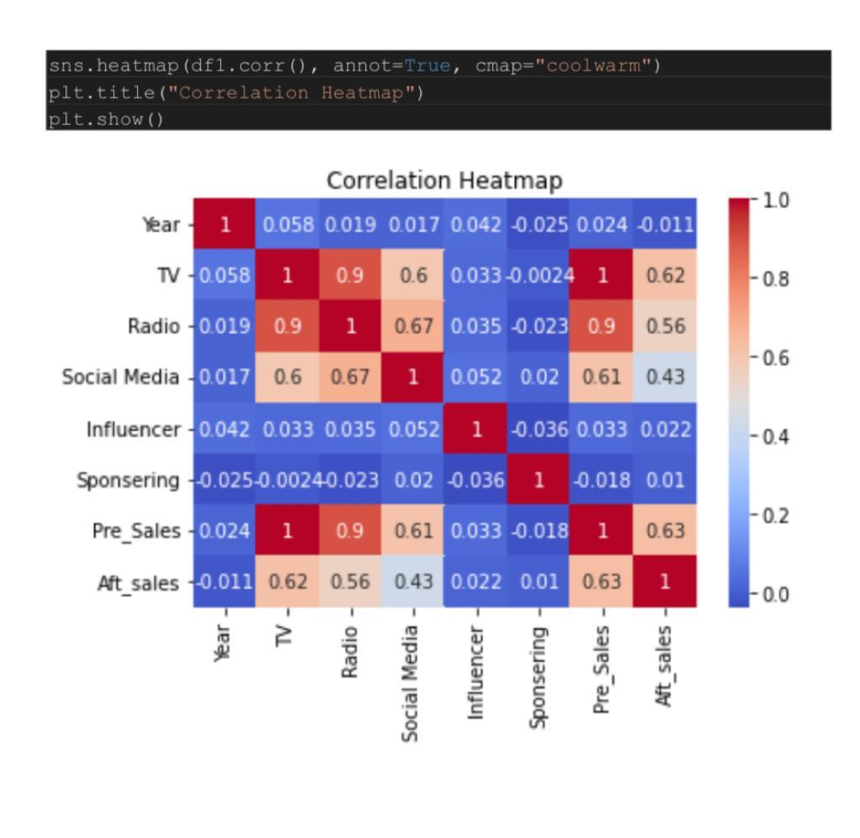
Results

Slide 14
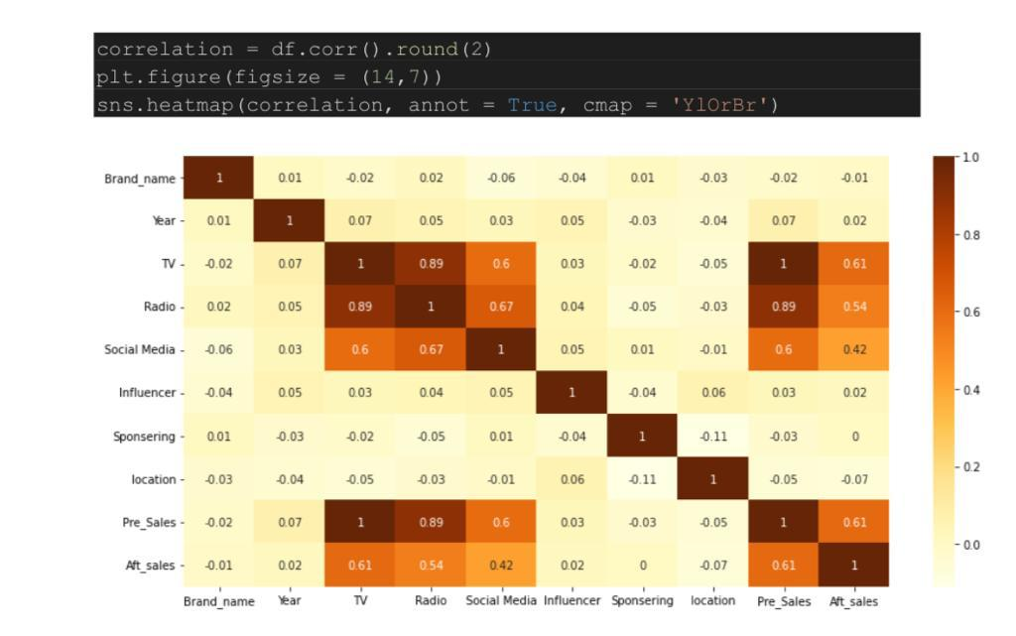
Results

Slide 15
Conclusion
The Conclusion of our analysis is that, advertising a key role in increasing of sales of any product.
From the dataset we have took very few categories of advertising platforms but there are many other platforms also.
As seen in the visualization product sales before marketing and after marketing are changed after the model being trained considering the amount spent on marketing.
The future scope for the project will be that as the main aim of this project is to know the relation among the sales ang the mode of marketing platform, the users can analyze and choose best platform so that they get maximum profits.
By using this they need not invest their money in all the modes of marketing but instead choose a best one.
In other mays it will also help the user to know how much average amount need to be spent for marketing.

Slide 16
References
While preparing the dataset, as we need few attributes like sales of companies in different years we preferred to
Dummy Marketing and Sales Data | Kaggle
The following dataset.
As we used Linear Regression, to know more in detail about it, we had a look at
Linear Regression in Machine learning - Javatpoint

Slide 17
THANK YOU

